Slide 1
Saliency Filters
Contrast Based Filtering for Salient Region Detection

Slide 2
Introduction
The computational identification that are likely to catch the attention of a human observer is a typical perceptual research problem.
The research indicate that the most influential factor in low level visual saliency is contrast
This project is based on the observation that an image can be decomposed into basic, structurally representative elements that abstract away unnecessary detail and at the same time allow for very clear and intuitive definition of contrast based saliency.

Slide 3
Processing Pipeline
Abstraction
Element Uniqueness
Element Distribution
Saliency Assignment

Slide 4
Abstraction
Decompose images into “elements” (superpixels) which represent relevant features of the image by abstracting unnecessary detail and clustering pixels.
These elements are perceptually homogeneous.

Slide 5
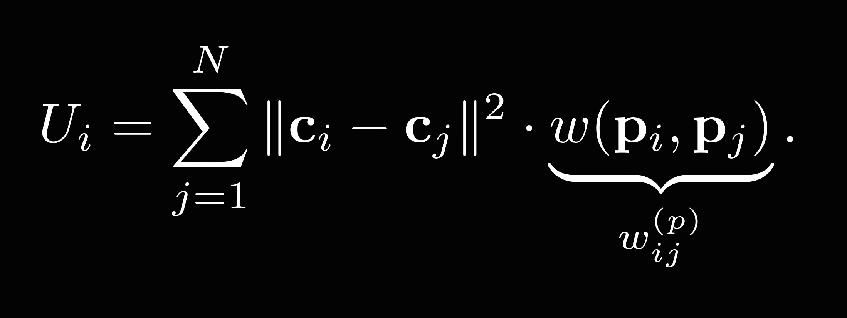
Element Uniqueness
Evaluate how different each respective element is from all the other elements that constitute the image by essentially measuring the “rarity” of each element.
This is the first contrast measures used to calculate saliency.

Slide 6
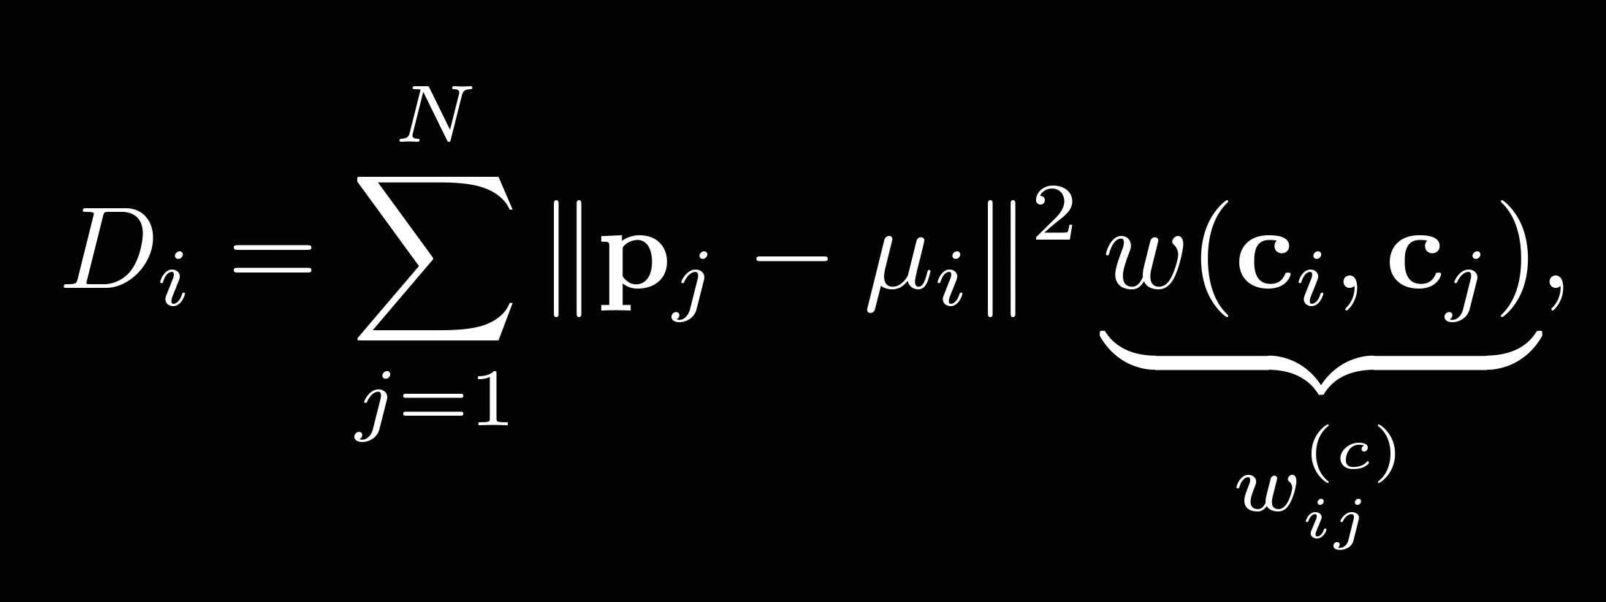
Element Distribution
It renders unique elements more salient when they are grouped in a particular region of the image rather than evenly distributed across the whole image.
This is the second contrast measure used to find saliency.

Slide 7
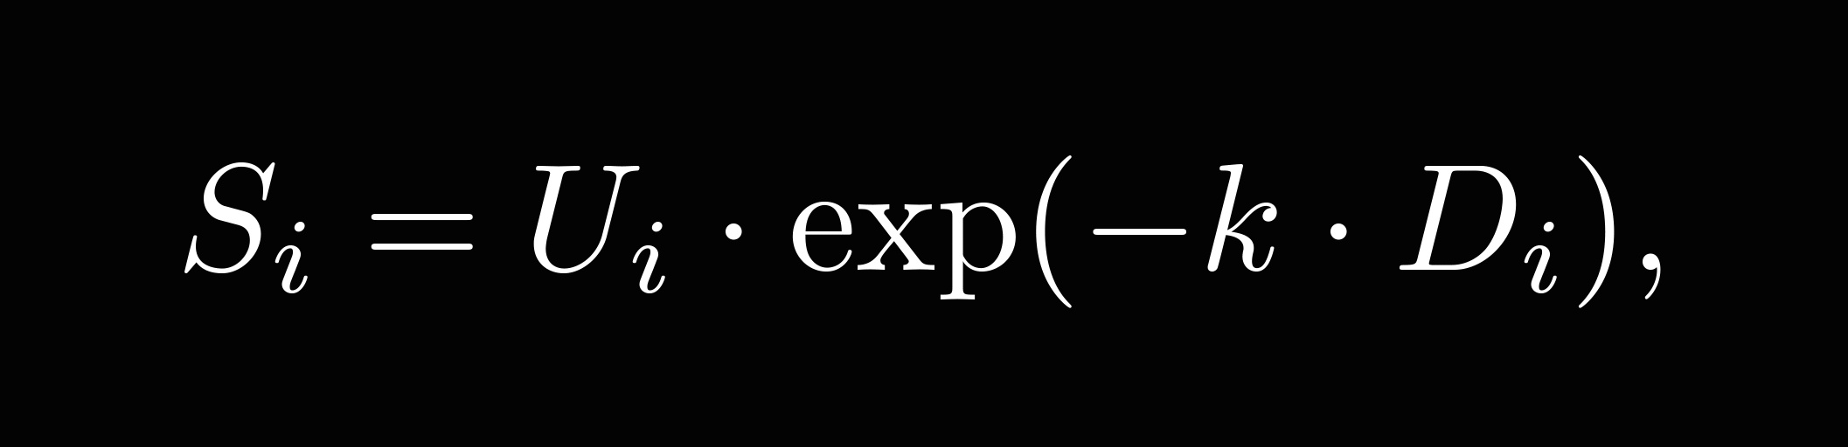
Saliency Assignment
The 2 contrast measures namely “Element Uniqueness” and “Element Distribution” are defined on a per element level.
Saliency Assignment as a final step of the pipeline assigns the actual saliency values to the input image to get a pixel accurate “Saliency Map” using the following equation.

Slide 8

Input image used

Slide 9

Abstraction

Slide 10

Element Uniqueness

Slide 11

Element Distribution

Slide 12
Project Milestones Achieved
Getting Accustomed To GitHub Environment
Understanding the concept of Contrast Based Filters
Implementing Abstraction
Implementing Element Uniqueness and Element Distribution

Slide 13
Milestones to be Achieved
Improving the result of “Element Distribution” by using the concept of Permutohedral Lattice
Implementing Saliency Assignment
Testing , Improvement, and running the algorithm on multiple images

